Slide 1

Jun 24, 2019 (A member of KBZ Group)

Slide 2
Background
IKBZ introduced a new motor claims process on April 01 2019
The salient features are:
Clear separation of duties between surveyors who go to accident side and back-office
Introduction of the role of claims handler in the back office to process a case from end to end
Introduction of the role of a claims manager to approve cases under 3Lakhs
Change in the approval limits of claims GM and DMD
A tracking tool was created to contain inputs from call centre, surveyors and claims handlers
This tracking tool allows analysis of the process

Slide 3
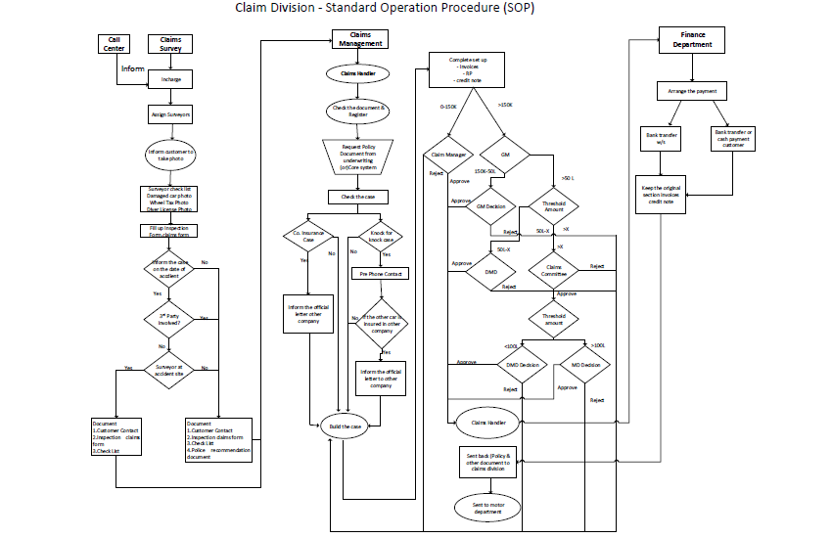
The claims process roughly involves 5 main parties
Call Centre
Finance
Claims Surveyor
Claims Handler
Claims Management and Approval Layer

Slide 4
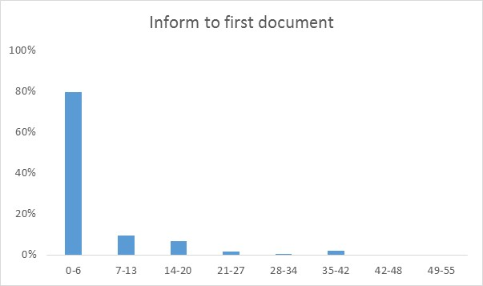
Getting the first document is quick but there is a long tail
In 80% of the cases, all documents, either from the surveyor (survey documents) or the customer (complete claims forms) are submitted within a week of IKBZ being informed of the accident. However there is a long tail.

Slide 5
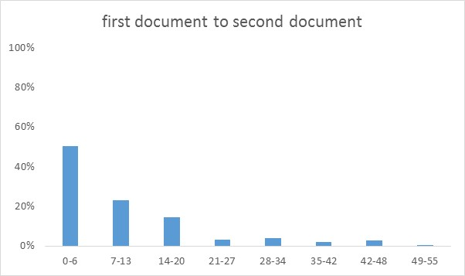
But there is a sometimes large gap between documents
However in only 50% of cases are all documents sent to claims handlers for processing within 1 week of the 1st set of documents. This is an area for improvement.

Slide 6
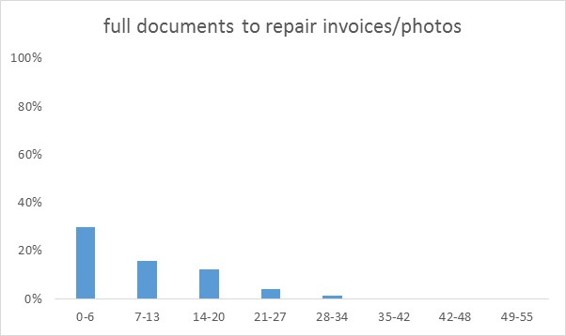
Most time is spent at the workshop (note: Thingyan)
Most time in the claims process is spent waiting for the vehicle to get repaired

Slide 7
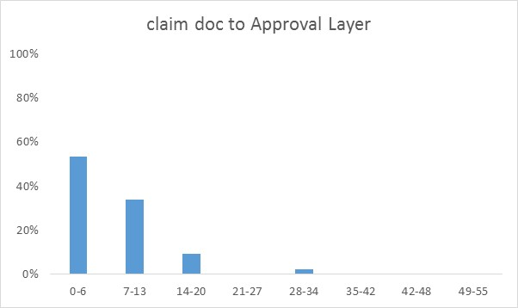
Preparation of documents for approval is time consuming
This area needs to be looked into deeper

Slide 8
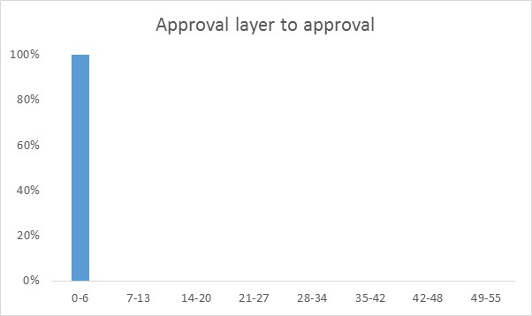
New approval layers are a success – no bottleneck
Approvals are not a bottle neck

Slide 9
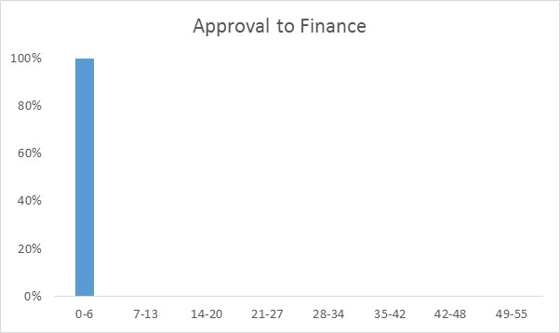
The cases efficiently move to finance for payment
Requesting payment to finance either

Slide 10
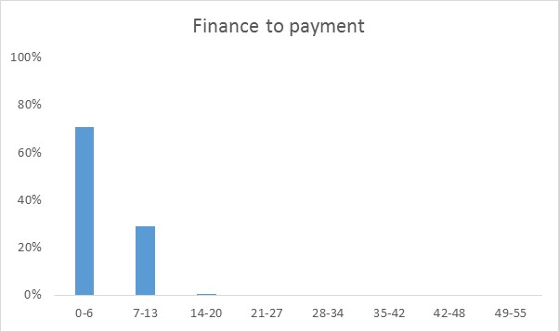
30% of cases take more than a week, worth investigating
In around 30% of cases, it takes more than a week to pay. This should be investigated with payment method. The recent push to bank transfer should help.

Slide 11
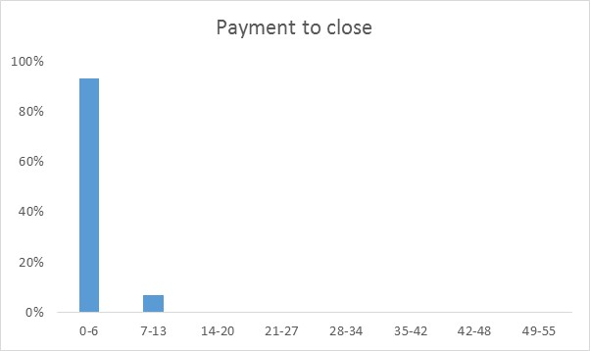
Case closure is fairly quick
Claims cases are closed fairly quickly after payment is done

Slide 12
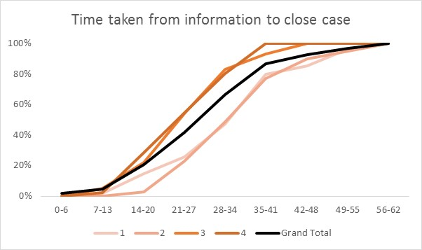
The change in process seems to make it faster
Breaking down the time to close cases by weeks on April, the time taken got shorter* as the staff got used to the process
* Data is biased since some cases, especially in the last 2 weeks of April have not been completed, but overall result stands

Slide 13
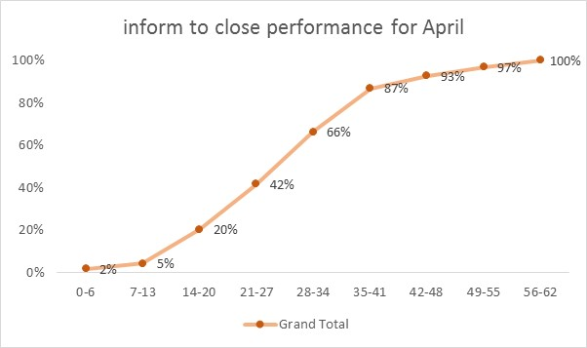
Around 2/3 of April cases are cleared within a month
Around 2/3 of cases are cleared within a month

Slide 14
Conclusion and Next Steps
It seems clear that the time takes to process motor vehicle claims is getting shorter
The new process implemented on April 1 is delivering results
These need to be tracked until stable performance and can be part of SLA to customers.
The analysis should be replicated with a longer time series
Tighter time bands (rather than weekly)
Further breakdowns : by town/branch, type of workshop…
Some areas need deeper analysis
Time taken for complete set of documents to be compiled
Repair Time and repair time estimation
Internal document compilation and preparation for submission to approval layer
Time from approval to payment

Slide 15
Appendix
First cut

Slide 16
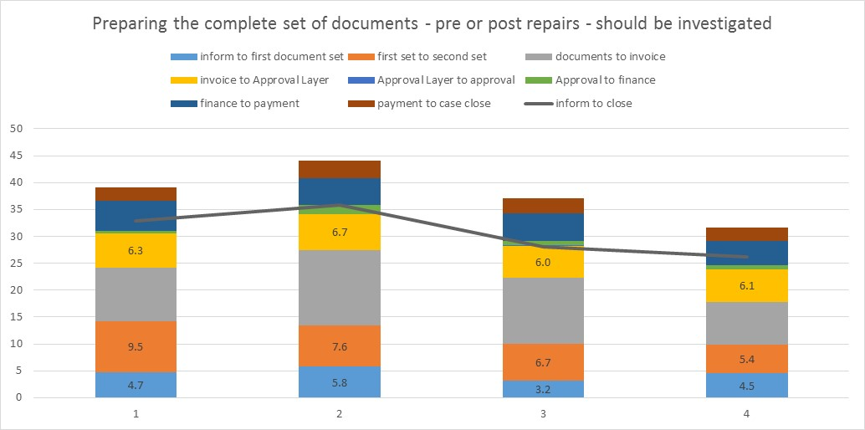
Preparing documents – Note not enough data for proper analysis
Gathering documents:
Data Lake
}
Document prep: automation?

Slide 17
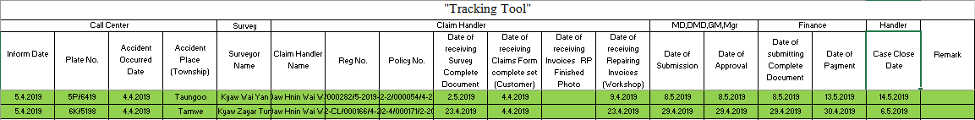
Sample of tracking tool

